Slide 1
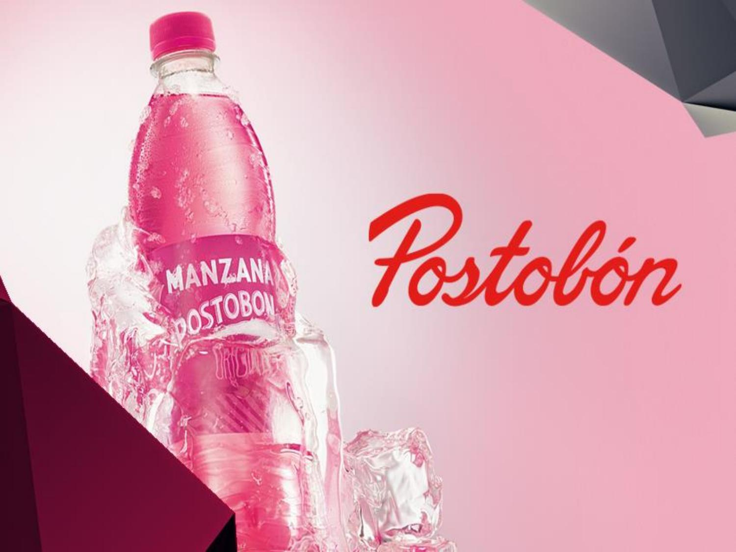


lOCATION
Workforce
Is location in different cities of Colombia and San Andres Islands and Providence.
11.122 people, of which 67% are distributors and the 33% are contractors.
Head Office
Is in Bogotá, but it comes from Medellín.
Non-alcoholic beverages
Carlos Ardila Lülle
Presentation

Slide 2

FINANCIAL REPORT
It’s between 10.000 and 11.000 pesos.
Net Profit
Turnover
It Is located in different cities of Colombia and San Andres Islands and Providence.
The annual turnover was 3,09 billions of pesos in year 2017.

Slide 3
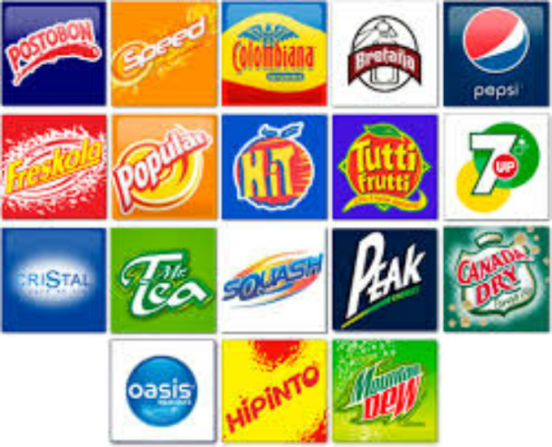
PRODUCTS
Postobon S.A has a wide range of products including drinks and non-alcoholic (beer through is subsidiary central Brewer Colombia), drinks fruit, water and other new generation (energizing and moisturizing.)

Slide 4
SUCCESS REASONS
The product quality.
They take into account the opinion of the public.
The promotions.
Export
They have different climates present and are based on production.
The infrastructure.
Good administration.
Customer service.
The large production of supply.
They have the environment in mind.

Slide 5
1904
HISTORY
Gabriel Posada and Valerio Tobón (hence the name Postobón) began producing soft drinks in Medellín, Colombia. Your first product called "Cola-Champagne"
1906
Posada and Tobón decided to open two factories: the first was opened in 1906 in Manizales and the second in Cali in the same year.
1918
1970
2006
This first product was distributed in a cart pulled by a donkey (called a porthole)
launched the brand of carbonated water "Brittany”
acquired the right to manufacture and market Pepsi Cola and Canada Dry beverages in the country.
Acquired the juice brand Tutti Frutti from Bavaria.
1917
Launch of "pepsi cola flavor agua mora"

Slide 6
MISSION
Fortalecer el liderazgo en el desarrollo, producción, mercadeo y ventas de bebidas refrescantes no alcohólicas, para satisfacer los gustos y necesidades de los consumidores, superando sus expectativas mediante la innovación, la calidad y la excelencia en el servicio. Generamos oportunidades de desarrollo profesional y personal apoyándonos en el talento humano organizado en equipos alrededor de los procesos. Trabajamos con los proveedores para convertirlos en nuestros socios comerciales. Contribuimos decisivamente al crecimiento económico de la Organización Ardila Lülle y del País, actuando con responsabilidad frente al medio ambiente y la sociedad.
The importance that postobon has for product quality and excellent customer service is highlighted, as well as for generating great opportunities by leaning on organized human talent and for working directly with its suppliers offering a quality product to the public. his responsibility to the environment and society.

Slide 7
VISION
Ser una Compañía Multilatina, con operaciones propias en el continente, reconocida por su dinamismo en innovar, desarrollar y ofrecer bebidas no alcohólicas de calidad, penetrando otros mercados e incursionando en otras categorías de producto.
The importance of postobon for offering quality products is highlighted, also for being an innovative company penetrating other markets and big having a variety of products.

Slide 8
SOCIAL RESPONSABILITY
Postobon invests in infrastructure, to have current sustainability criteria that optimize the use of resources (less waste water, use of recyclable raw material)

Slide 9
SOCIAL RESPONSABILITY
Postobon focuses on the current care of the environment with the reduction of carbon dioxide one of the main objectives, acquired 52 trucks of low level in polluting emissions and also contributes to healthy mobility.

Slide 10

THANKS
We thank SENA in the first place for giving us the opportunity to carry out this work for the strengthening of the administrative processes of the company POSTOBON SA, we also want to thank the information that could be obtained from the research pages and that served us for the explanation of this didactic primer, this information was used to efficiently and effectively elaborate the didactic primer, however, at the end there is the reference (links) of the pages where the information was used, respecting the author's rights.

Slide 11
CIBERGRAFIA
https://en.wikipedia.org/wiki/Postob%C3%B3n
https://prezi.com/90q4hwiyvlaq/breve-resena-historica-de-postobon/
http://www.postobon.com/

